Slide 1


Evaluating Magic: The Gathering Price Changes
Sage Gray
DATA 304
5/6/2024

Slide 2

Statement of Problem
Magic: The Gathering’s cards are constantly changing prices
New players are likely to lose money buying high value cards
Information is available, not easy to digest
Notes:
So, the problem I’m trying to solve is as follows: New players coming into the game are going to spend too much money on new and old cards.
The prices of magic cards are in constant flux, and to the untrained eye these price changes look random.
There is information about the prices of cards, but it’s geared towards enfranchised players who are familiar with the market
To try and combat this, I decided to scrape that information from websites that sell cards and track the changes in price over time

Slide 3


Data Scraping
Card Data
Pull information from TCGPlayer.com, a website for buying and selling cards
Scrape
Scrape prices and card images, names, and rarities.
Be Polite
Adhere to TCGPlayer’s scraping requirements through R’s “polite” package to “bow” and “scrape”
Ingests a website’s “robots.txt” page to make certain the user is not accidentally DDOS-ing the website
Notes:
To do this, I pulled information from tcgplayer.com using Rselenium. I tried to use the simpler Rvest package, but tcgplayer’s online shop is loaded dynamically, so I needed to be able to scroll to the bottom of the page before scraping. I took the prices, names, image urls, and rarities from the website through R’s polite package to make sure I adhere to the website’s robots.txt file. This makes sure I’m sticking to the rules they’ve set in place to keep their data and website safe.

Slide 4


Transforming the Data
Scraped data are loose strings and urls
Need to organize the data into a Time Series format
Keep separate SQLite tables for static card information and prices/dates
Notes:
This product is a proof of concept, so I’m just pulling data from one set of 254 cards for one week.
And since this information is basically just loose strings and doesn’t have any associated date on its own, I needed to adjust the data to make use of it.
I tracked the date of each scrape and assigned the price for that day into a SQLite table and kept the static information, the name, image url, and rarity, in a separate table that didn’t need to be updated

Slide 5






Architecture
Store Data in SQLite Database
Host Web Application through Shiny
Scrape with RSelenium
Clean, Process, Format data with R
Notes:
Here’s the basic breakdown:
I pulled info with Rselenium and polite
I took it into an RMD file to clean the data, format it, and make it easy to access and use, then stored it in a SQLite database. I updated the price data every day for a week, then combined the RMD and SQLite database into a single shiny app that displayed the UI and all the required graphs.

Slide 6

Data Output
A ShinyApp that tracks the most recent increases and decreases in card prices
Displays the top 5 price hikes, dips and amount
Option for tracking specific card prices
https://sgray38.shinyapps.io/magic_scrape/
Notes:
So, final product is a Shinyapp that tracks the top 5 changes in card prices and displays them as soon as you launch the app. Then it’s got a button to let you choose specific cards and see their price changes over the week I scraped data.

Slide 7
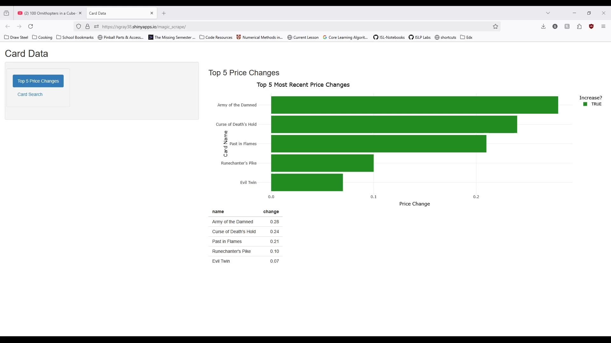

Demonstration
Notes:
Here’s a demonstration of the app, you can see the top five absolute value changes between the last day of the week and the day before.
The green bar shows the change was an increase in price, and if it had been a decrease the bar would be red.
All of these price changes are 30 cents or less, this is an old set and price changes for these cards have been mostly incidental.
Here you can see the two buttons, and clicking card search will change the UI like so
You can see the fluctuations in price over the week in the graph and an image of the card under these dropdown menus.
Changing Rarity lets you choose between lands, tokens, and the various rarities of cards in this set, and then the card dropdown changes based on the rarity dropdown.

Slide 8


Value Proposal
Allows users to immediately see which cards have increased or decreased in price
Also check for price changes on preferred cards
Players can see if it is worth buying the card now or waiting for a future drop
Additional benefit of providing insights on selling cards they don’t need
New players will have access to visualized price changes that may not have been obvious
Notes:
This app gives users a chance to measure the market before buying or selling cards. Ideally this will give new players of magic some idea on whether now is a good time to buy that card they were eying and give enfranchised players an opportunity to decide if now is a good time to offload some cards they don’t need anymore.

Slide 9

Thank you!
Sage Gray sgray32419@gmail.com University of Tennessee, Knoxville

